Slide 1

Foundations & Circuit Switching
The philosophy and architecture of routing data through finite physical infrastructure, enabling infinite conversations to share limited resources.

Slide 2

The Philosophy & Architecture of Circuit Switching
The Goal
Routing data and sharing finite physical infrastructure among infinite conversations.
Circuit Switching
Pre-allocates a dedicated, end-to-end path before sending data.
01
02
03
Setup
Data Transfer
Teardown
Reserves bandwidth and resources
Continuous bit stream with guaranteed capacity
Explicitly releases resources
Total Time Calculation: Transmission time (\frac{L}{R}) happens only once.

Slide 3

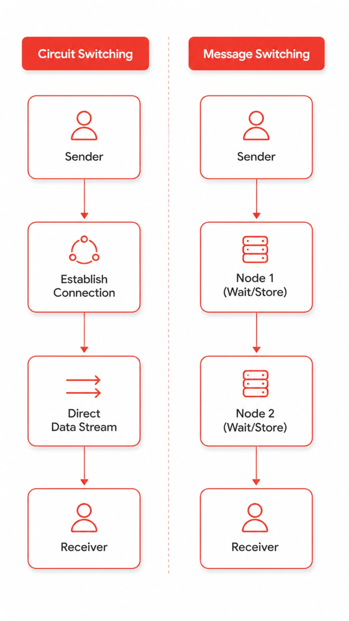
Switching Fabrics & Message Switching
Space-Division Switching
Uses physical paths such as crossbars and Clos Networks to create dedicated connections.
Time-Division Switching
Swaps time slots using memory through Time Slot Interchangers to share physical infrastructure.
Message Switching (The Precursor)
Store-and-Forward: Entire message sent, stored at a node, then forwarded
The Flaw: Requires massive buffers. One bit error means retransmitting the entire file

Slide 4
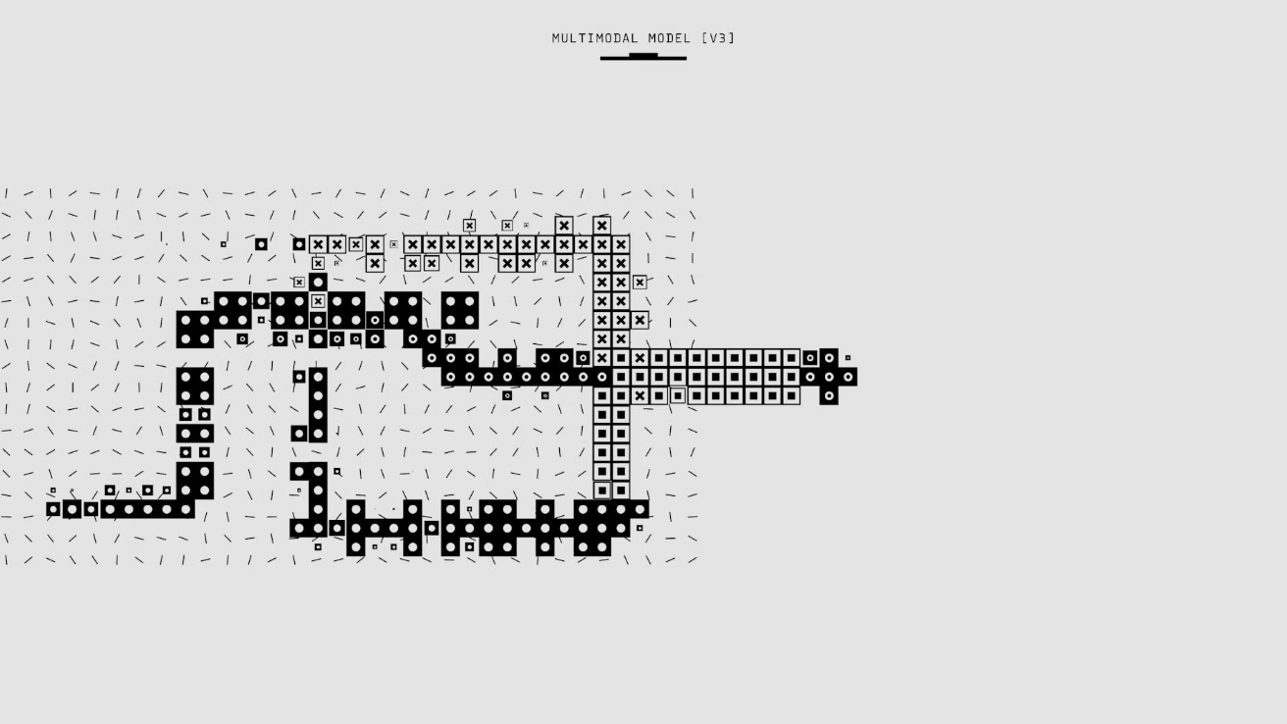

Timing Visual: Circuit vs. Message Switching
Message Switching
Circuit Switching
A "staircase" effect. Data stops entirely at each node to be stored before moving to the next, multiplying transmission delays.
A single diagonal setup line, followed by a smooth, parallel transfer of data. Delay is purely propagation.

Slide 5
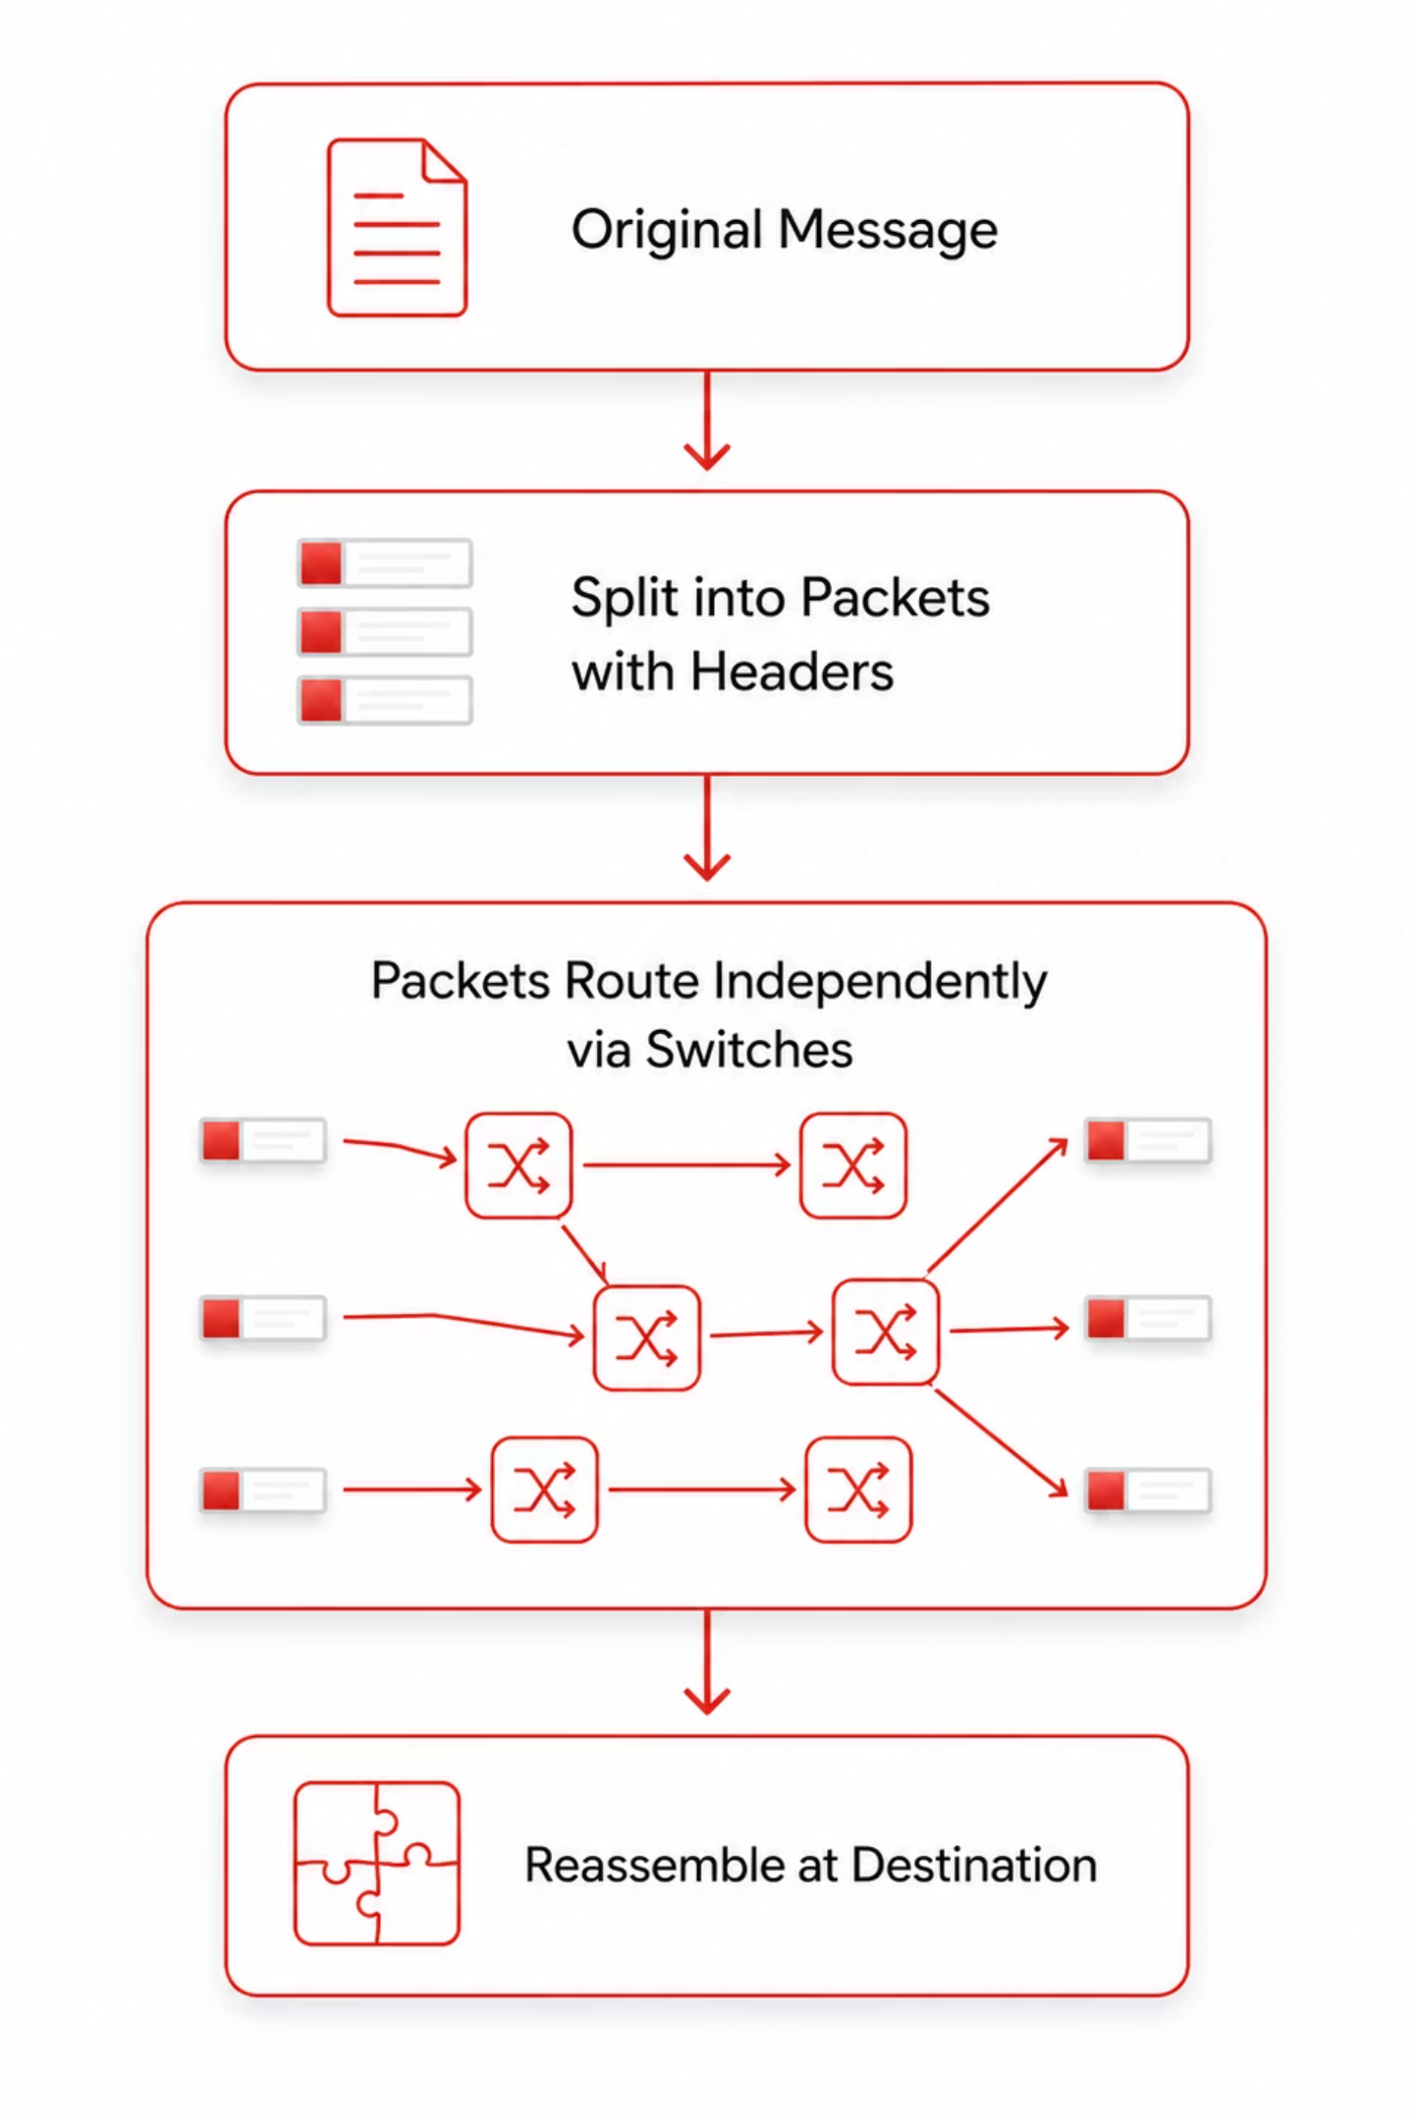
Packet Switching (The Modern Standard)
Messages are fragmented into smaller blocks (packets) with a header and payload.
Datagram Networks (e.g., IP)
Connectionless
Packets routed independently
Arrive out-of-order
Highly scalable and resilient to failures
Virtual Circuit (VC) Networks (e.g., ATM)
Connection-oriented
Setup creates a fixed logical path
Packets arrive in order
Physical wire is still shared dynamically

Slide 6




Inside the Router: Advanced Nuance
Head-of-Line (HOL) Blocking
Occurs in input-queued switches. The first packet in line waits for a busy output, blocking all packets behind it (even if their outputs are free).
The Problem
The Solution
The Result
HOL blocking reduces throughput to ~58%
Virtual Output Queuing (VOQ)
Throughput boosted to nearly 100%
Virtual Output Queuing (VOQ): Input queues keep separate logical lines for each output port, eliminating HOL blocking.

Slide 7
Comparing Switching Paradigms
Feature
Circuit Switching
Datagram Packet
Virtual Circuit Packet
Dedicated Path
Yes
No
Yes (Logical)
Bandwidth
Reserved / Guaranteed
Dynamic / Best Effort
Reserved / Managed
Setup Phase
Required
None
Required
Header Size
None (after setup)
High (Full IP address)
Low (Short VC tag)

Slide 8
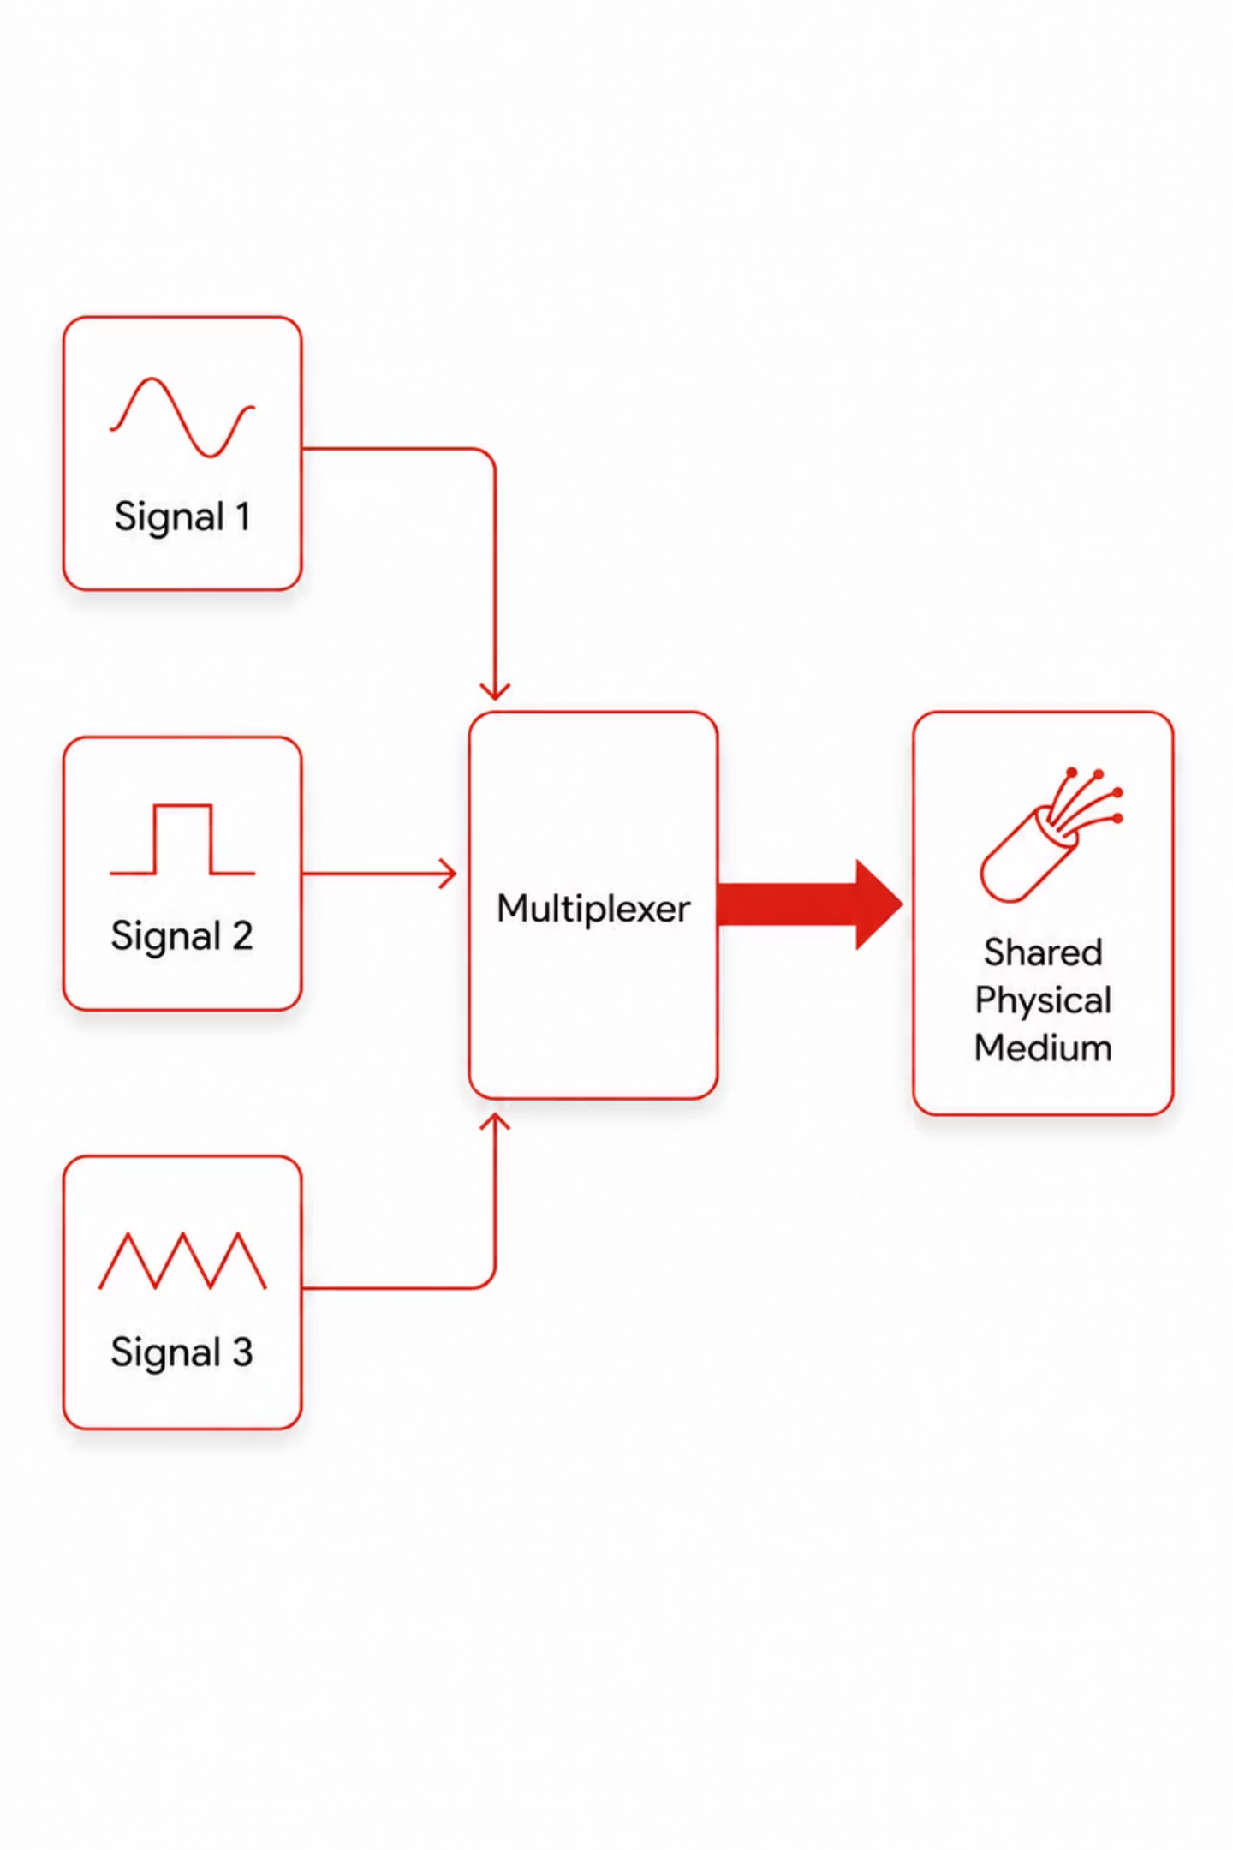

Multiplexing Foundations
Goal: Multiple signals sharing a single physical wire/fiber.
Frequency Division Multiplexing (FDM)
Divides spectrum into frequency channels, separated by empty "guard bands" to stop interference.
Wavelength Division Multiplexing (WDM)
FDM for fiber optics. Multiple lasers shoot distinct colors (wavelengths) down one fiber.

Slide 9

Synchronous Time Division Multiplexing (STDM)
Mechanism
Divides time into fixed frames and slots. Samples inputs in strict round-robin order.
Data Rate Calculation
Multiplexing N sources at R bps requires link capacity:
The Inefficiency
If a source is idle, its assigned time slot travels empty. Bandwidth is wasted.

Slide 10
Statistical TDM & Expert Synthesis
Statistical TDM (ATDM)
The Trade-off
The Risk
Solves STDM's wasted space by allocating slots dynamically, strictly on demand.
Every packet must carry an addressing header to identify the sender.
Deep buffers are needed. If everyone transmits at once, queuing delays (jitter) occur.

Slide 11
Statistical Multiplexing Gain (SMG)
Capitalizes on "bursty" traffic (users alternate between idle and downloading). Allows ISPs to oversubscribe links intentionally.
SMG = \frac{\sum_{i=1}^{N} R_{peak_i}}{C_{link}}
SMG > 1: Successful over subscription, relying on the statistical probability that not everyone transmits simultaneously.

Slide 12
STDM vs. Statistical TDM
Feature
Synchronous TDM (STDM)
Statistical TDM (ATDM)
Allocation
Fixed, round-robin
Dynamic, demand-driven
Overhead
None (position = ID)
Required in every slot
Efficiency
Low (wastes idle slots)
High (near 100% efficient)
Best For
Uncompressed Voice/Video
Bursty Data (Internet)

